Slide 1
Pension Funds and Financial Stability
Shelton Nicholls
Resident Adviser on Financial Stability, CARTAC
Presentation to the Caribbean Association of
Pension Supervisors Workshop, Conference and Annual General Meeting, Suriname, June 20-21, 2016.

Slide 2
Agenda
Role of Pensions in the Financial System and Macroeconomy
The Caribbean Pension Sector: Stylized Facts and Key challenges
Pension Sector Vulnerabilities and Financial Stability
Measuring Systemic Risk
Pension Sector Contribution to the Financial Stability Work Plan: Some Issues for Consideration.

Slide 3
#1 Role of Pensions in the Financial System and Macroeconomy

Slide 4
1.1 The Concept of Pensions
What is a Pension Fund: Any plan, fund or scheme that guarantees retirement income.
Ultimately, pensions have long-run macroeconomic effects through two broad mechanisms in the savings-investment process:
Indirect Finance (Financial Intermediation)
Direct Finance (i.e. Financial markets via longer-term financial instruments (e.g. equity and bonds)).

Slide 5
1.2
Governance, Financial Legislation, Regulations and Standards
INDIRECT FINANCE
Financial Intermediaries
Non-Deposit Taking
Deposit Taking
Credit Unions
Banks
Pensions
Insurance
S
A
V
E
R
S
B
O
R
R
O
W
E
R
S
DIRECT FINANCE
Financial Markets
Equities
Mutual Funds
Bonds
TBills
Forex
PAYMENT SYSTEMS
REST OF THE WORLD

Slide 6
1.3 The Savings Process
Life-Cycle Model
Smoothing of consumption over an individual’s life-time (Inter-temporal horizon);
Bequest Model
Bequeathing savings to siblings and family (multi-generational horizon);
Precautionary Model
Saving to cope with uncertain death, extraordinary health expenditures and/or income disruption (precautionary Motive);

Slide 7
1.4 Modalities for Retirement Savings (World Bank)
Non-Contributory State Pension (zero pillar)
Mandatory Contributory Scheme (First Pillar)
Mandatory contributions linked to earnings and replacing some fraction of life-time pre-retirement income.
Mandatory Defined Contributory Scheme (Second Pillar)
Mandatory defined contributory plan with independent investment management.
Non-contributory benefits financed by the State, fiscal situation permitting.

Slide 8
1.4 (cont’d) Modalities for Retirement Savings (World Bank)
Voluntary Contributory Scheme (Third Pillar)
Non-financial Scheme (Fourth Pillar)
Informal family support; other social programs (health care, housing, etc).
Employer-sponsored pensions (Defined Contribution, Defined Benefit, Hybrid Scheme) and Individual savings.

Slide 9
1.5 Role of Pension Funds in the Economy
Help with the mobilisation and management of savings;
Assist with income stability;
Help labour market efficiency;
Support the growth of the economy through long-term investments.
Since pensions are ultimately about retirement income, the interplay between demographic conditions with the savings-investment process could have important financial and macroeconomic consequences.

Slide 10
1.6 Pension Funds: Transmission Channels to the Macroeconomy
Through Balance Sheets of Sponsors;
Through Balance Sheets of Households (via Asset Volatility);
Through Balance Sheet of the Government via explicit or implicit guarantees;
Through the financial system from investing activities of pension plans.
Source: Impavido et al (2009): “How the financial crisis affects pensions and insurance and why the impacts matter” WP/09/51.

Slide 11
#2 The Caribbean Pension Sector: Stylized Facts and Key Challenges

Slide 12
2.1 Private Pension Plans: Caribbean Financial Sector
Public disclosure of Prudential and Financial Information on occupational pension activity is quite limited in many countries in the Caribbean region.
Pension assets though are not unsubstantial in many Caribbean territories.
Pension Investments are concentrated in broadly two major asset classes (gov’t bonds, equities).

Slide 13
2.2 Caribbean Financial Assets (% of GDP)
Source: IMF

Slide 14
2.3 Private Pension Plans: Caribbean Financial Sector
Country | Year | No. of Plans | Total Pension Assets (US$M) | % of Financial System Assets | % of GDP
Bahamas | 2007 | ?? | 1,100.0 | ?? | 15.4
Barbados | 2015 | 305 | ?? | ?? | ??
Belize | 2015 | ?? | ?? | ?? | ??
ECCU | 2015 | ?? | ?? | ?? | ??
Guyana | 2015 | ?? | 156.3 | 5.1 | 3.9
Haiti | 2015 | ?? | ?? | ?? | ??
Jamaica | 2015 | 415 | ?? | 11.5 | 22.6
Suriname | 2014 | 38 | 580.0 | 13.9 | 9.5
Trinidad and Tobago | 2015 | 191 | 7,643.4 | 16 | ??

Slide 15
2.4 Types of Pension Plans: Caribbean Financial Sector
Country | Year | Number of Pension Funds | Type of Pension Funds
 |  |  | Defined Contribution | Defined Benefit | Hybrid
Bahamas | n.a. | n.a. | n.a. | n.a. | n.a.
Barbados | 2015 | 305 | 187 | 99 | 12
ECCU | n.a. | n.a. | n.a. | n.a. | n.a.
Guyana | n.a. | n.a. | n.a. | n.a. | n.a.
Haiti | n.a. | n.a. | n.a. | n.a. | n.a.
Jamaica | 2015 | 415 | 308 | 107 | -
Suriname | 2014 | 38 | 1 | 2 | 27
Trinidad and Tobago | 2015 | 191 | n.a. | n.a. | n.a.

Slide 16
2.5The Bahamas Private Pension Investments, 2007
 | Funds Invested B$ Million | Funds Invested as a % of Total Funds
Government Bonds | 399,980 | 35.66
Bank Deposits | 190,984 | 17.18
Real Estates | 12,789 | 1.15
Employer’s Business | 6,635 | 0.60
Mortgages | 16,813 | 1.51
Private Sector Bonds | 1,176 | 0.11
Equities | 259,048 | 23.31
Mutual Funds | 104,946 | 9.44
Loans | 25,434 | 2.29
Contributor | 5,737 | 0.52
Dividends | 4,653 | 0.42
Other Investments | 83,303 | 7.49
Total Funds | 1,111,498 | 100
Source: The Central Bank of The Bahamas Survey on Pension Funds & Central Bank Estimates

Slide 17
2.6 Jamaica Pension Plan Investment Structure as at September 2015 (in JMD Billions)
Investments | Sep-15
 | Amount | As % of total assets in pension industry
Government Securities | 135.8 | 37.0
Equities | 40.7 | 11.1
Real Estate | 20.9 | 5.7
Arrangements (Deposit Admin Contracts and Pooled Funds) | 114.5 | 31.2
Other Investments | 52.8 | 14.4
Total Assets (Jamaican $ Bn) | 367.0 | 100.0

Slide 18
2.7 Suriname Pension Fund Investment Structure as at 2014 (in SRD Millions)
Investment | 2014
 | Amount | In % of Total Investments
Real Estate | 242.4 | 16.3
Mortgage | 271.6 | 18.3
Personal Loans | 1.4 | 0.1
Private Loans | 28.4 | 1.9
Shares | 192.3 | 12.9
Bonds | 302.4 | 20.3
Term Deposits | 221.7 | 14.9
Saving Accounts | 92.0 | 6.2
Gold Certificates | 15.0 | 1.0
Treasury Bills | 65.0 | 4.4
Current Account with the Employer | 22.5 | 1.5
Other | 32.0 | 2.1
Total Investments | 1,486.7 | 100.0

Slide 19
2.8 Trinidad & Tobago Occupational Pension Plans Investments, June 2012
 | Funds Invested TT$ Million | Funds as a % of Total Assets
T&T Government Securities | 9356.6 | 28.8
Corporate Securities | 4145.0 | 12.8
Mortgages | 172.6 | 0.5
T&T Equities | 9425.0 | 29.0
Fixed Deposits | 3965.7 | 12.2
Other T&T Assets | 994.6 | 3.1
Foreign Government Securities | 716.1 | 2.2
Other Foreign Securities | 376.9 | 1.2
Foreign Equities | 3333.9 | 10.3
Total Assets | 32486.3 | 100.0
Source: Central Bank of Trinidad & Tobago Financial Stability Report Year–End Review

Slide 20
#3 Pension Sector Vulnerabilities and Financial Stability

Slide 21
3.1 Core Principles of Financial Stability:
Schinasi’s Principles
Efficient and Smooth Allocation of Resources
Facilitate efficient and smooth allocation of resources inter-temporally and spatially between savers and investors.
Effective Management of Forward-looking Risks
Enable forward-looking risks to be continuously assessed, reasonably priced and effectively managed.
Absorption and Dissipation of Financial and Economic Shocks
Be able to contain and absorb financial and economic shocks with minimal disruption to financial and economic activity.

Slide 22
3.2 Systemic Risk and Financial Stability
Global financial crisis and the reverberations from the collapse of a key regional financial conglomerate (CL Financial) have brought to the fore the importance of understanding and managing systemic risks in the Caribbean region.
Systemic Risks: The risk that an event could trigger a loss of value or confidence in a substantial portion of the financial system which can materially affect economic growth and economic welfare.“

Slide 23
3.3 Dimensions of Systemic Risk
Time-Series Dimension (Time-Varying)
Risks caused by the pro-cyclicality of the financial system.
Cross-Sectional Dimension
Spillover/contagion effects arising from interconnectedness or through common exposures.
(Progressive build-up/unwinding of aggregate risk over time).

Slide 24
3.4 Key Caribbean Pension Sector Vulnerabilities
As significant vehicles for retirement savings, pension plans are exposed to certain key vulnerabilities (See Impavido and Tower (2009), WP/09/51)
Asset-Liability Shocks;
Shocks to the Income Statement (Decreased Income);
Shocks to Plan Contributions from the economic slowdown;

Slide 25
3.5 Key Caribbean Pension Sector Risks (cont’d)
(a) Asset-Liability Shocks:
Fixed Income assets and to some extent equities feature prominently in the asset allocation mix of pension funds in the Caribbean. Major shocks arise from:
Falling Equity Prices;
Downgrade in government bond ratings which reduce bond prices and asset valuations in pension fund balance sheets.

Slide 26
3.6 Key Caribbean Pension Sector Risks (cont’d)
(b) Shocks to the Income Statement:
Plans have been significantly impacted by falling interest rates which have affected pension income.
(c) Shocks to Plan Contributions:
A slowdown in economic activity (as well as rising unemployment) has translated into lower contribution income which in turn has affected the funding status of pension plans.

Slide 27
3.7 Pension Funds: Source of Systemic Risk and Financial Instability?
Can pension funds give rise to systemic risks?
Pension Plans are one of the larger classes of institutional investors and can have a significant effect on financial markets.
Sizeable re-allocations of assets (between fixed income and equities) in pension plans can also significantly impact financial stability.
Ageing population can lead to growth in relative size of pension liabilities and investment risks.

Slide 28
#4 Measuring Risks and Vulnerabilities

Slide 29
4.1 Measuring Risks and Vulnerabilities
Financial Soundness Indicators and Macro-prudential Indicators
Systemic Risk Measures: Composite Index of Systemic Stress
Stress Tests

Slide 30
4.1a Pension Fund FSIs
No comprehensive framework exists for Financial stability indicators in the pension sector akin to CAMELS for Banks or CARAMELS for insurance. Some broad principles from these frameworks could be adopted where they apply.
World Bank consultants have been working on an Outcome-based Assessment (OBA) framework for pensions (Price, Ashcroft and Hafeman) but this relates more to social security considerations.

Slide 31
4.1b Proposed Draft Framework for Pension Indicators (Cont’d)
Framework emphasizes (Coverage, Adequacy, Sustainability, Efficiency, Security )-CASES (author’s acronym)
Coverage: Maximizing proportion of working age population accumulating retirement income entitlements.
Adequacy: Protecting retirees against severe drops in living standards and poverty by ensuring that they have accumulated adequate retirement benefits.
Sustainability: Delivering promised retirement income without placing burdens that will not be met on government, employers or workers.
Efficiency : How well pension plans transfer contributions to pension income.
Security: Minimizing the risk that funds that have been accumulated to provide retirement benefits are misappropriated.

Slide 32
4.1c Gauging Pension Sector Impact on Financial Stability : Difficult without Information
Not all aspects of CASES methodology map directly to financial soundness and stability.
No separate compilation guide exists for the non-DTI sector, but the IMF has suggested compilation of the following four indicators for the pension sector.
Liquid assets to estimated pension payments in the next year (Liquidity ratio)
Return on Assets (Earnings and Profitability)
Pension Fund Assets/Total Financial System Assets
Pension Fund Assets/GDP

Slide 33
4.1d (cont’d) Gauging Pension Sector Impact on Financial Stability: Difficult without Information
Because pension plans are significant vehicles for retirement savings and are exposed to many important risks including solvency, liquidity, asset-liability mismatches and inadequate plan contributions, to mention a few, there is a need to map out a potential list of financial soundness indicators for the pensions sector.

Slide 34
4.2 Essential Features of a Systemic Risk Surveillance Framework
Scope of systemic risk indicators (SRIs) should incorporate potential external and internal shocks that could disrupt the orderly functioning of financial institutions, financial markets and financial infrastructure with substantial impairment to the real economy.
SRIs should help identify and assess emerging systemic risk based on underlying macro-prudential indicators in order to prevent financial crisis.
Should be able to rely on current value of SRIs to substantiate (or not) the need for policy action and the rationale underpinning the selection of instruments if action is required.
Systemic risk surveillance requires analysis of SRIs across borders for regionally interconnected financial systems.

Slide 35
4.2a Proposed SRIs for the Caribbean
Banking Stability Index (BSI) is a weighted average of normalized indicators of capital adequacy, profitability, asset quality, balance sheet liquidity, fx risk and interest rate risk (Geršl A., and J. Hermánek, 2008).
Aggregate Financial Stability Index (AFSI) is a weighted average of normalized balance sheet and macroeconomic data (including international factors) to form an aggregate measure of financial stability (Cheang and Choy, 2011).
Absorption Ratio (AR) is computed as the fraction of the total variance of a set of time series explained or “absorbed” by a limited number of eigenvectors from Principal Components Analysis (Kritzman, Li, Page and Rigobon, 2011).
Credit-to-GDP Gap is a forward-looking measure based on the assessment of deviations of factors determining the degree of leverage from their normal or equilibrium values estimated by applying a statistical filter to the time series (Borio, C, and M. Drehmann, 2009).
Composite Index of Systemic Risk (CISS) is a single measure of financial stress and reflects the joint impact of activity across financial markets using empirical distribution functions and portfolio theory to determine contemporaneous stress in the most active markets (D. Holló, M. Kremer and M. Lo Duca, 2012).

Slide 36
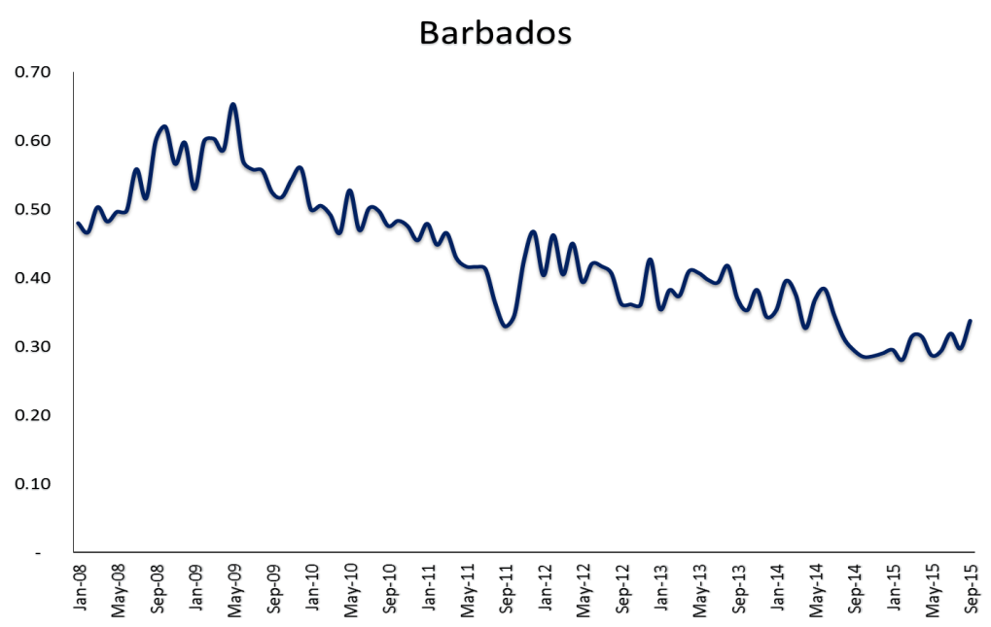
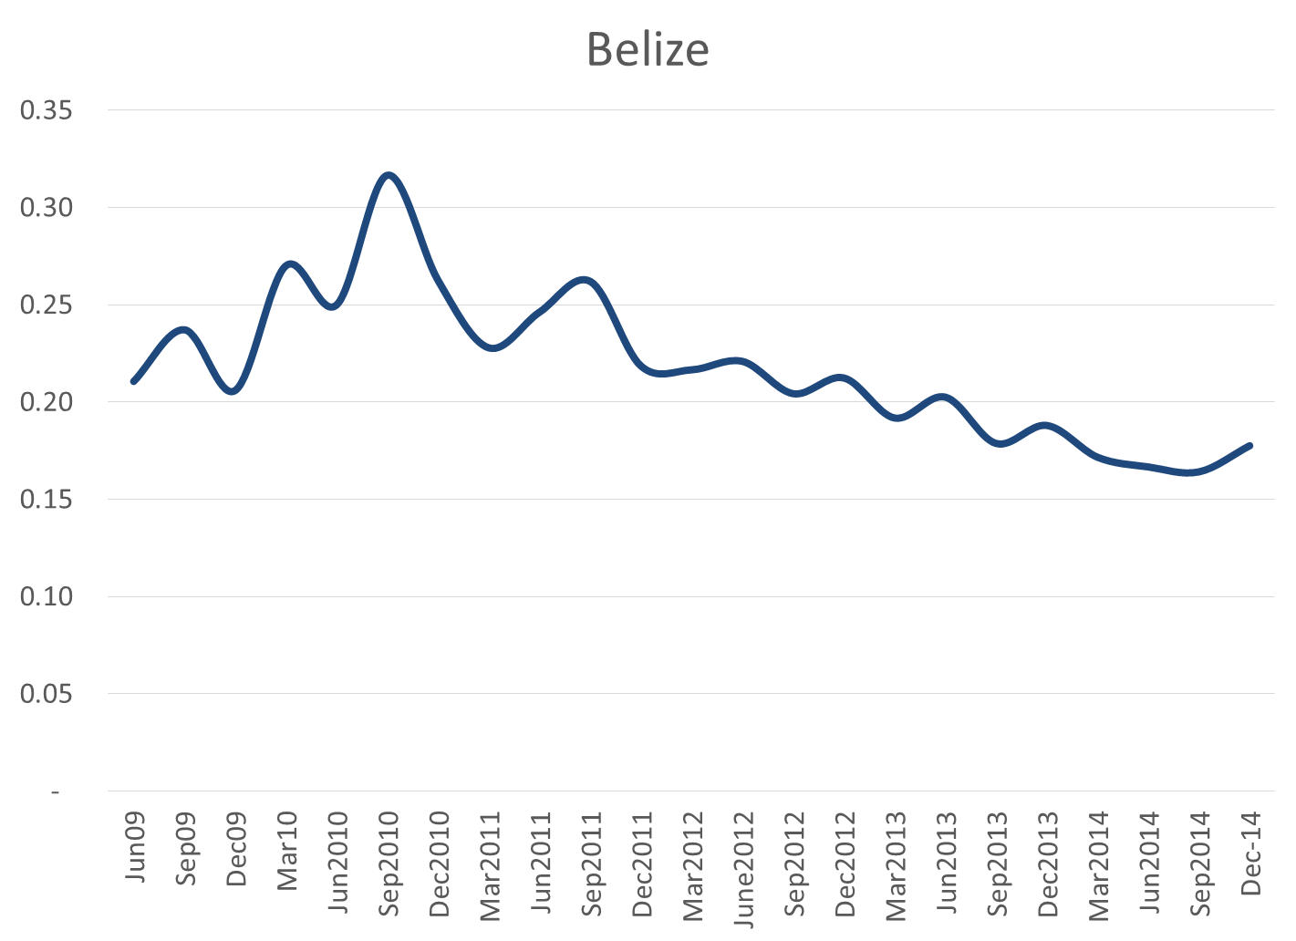
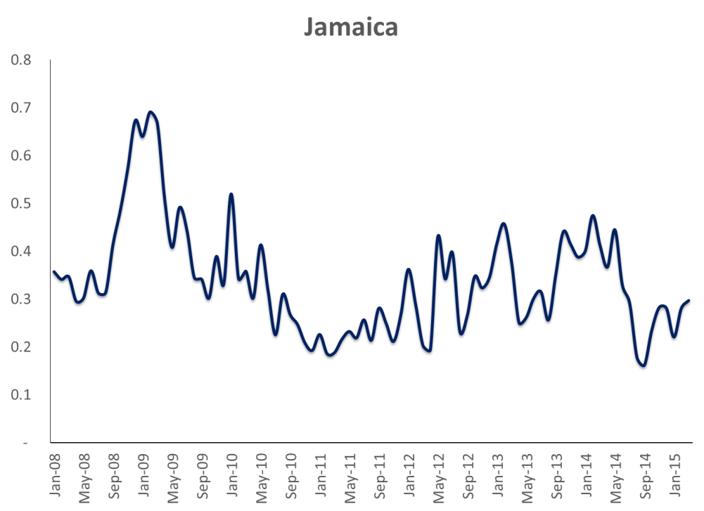
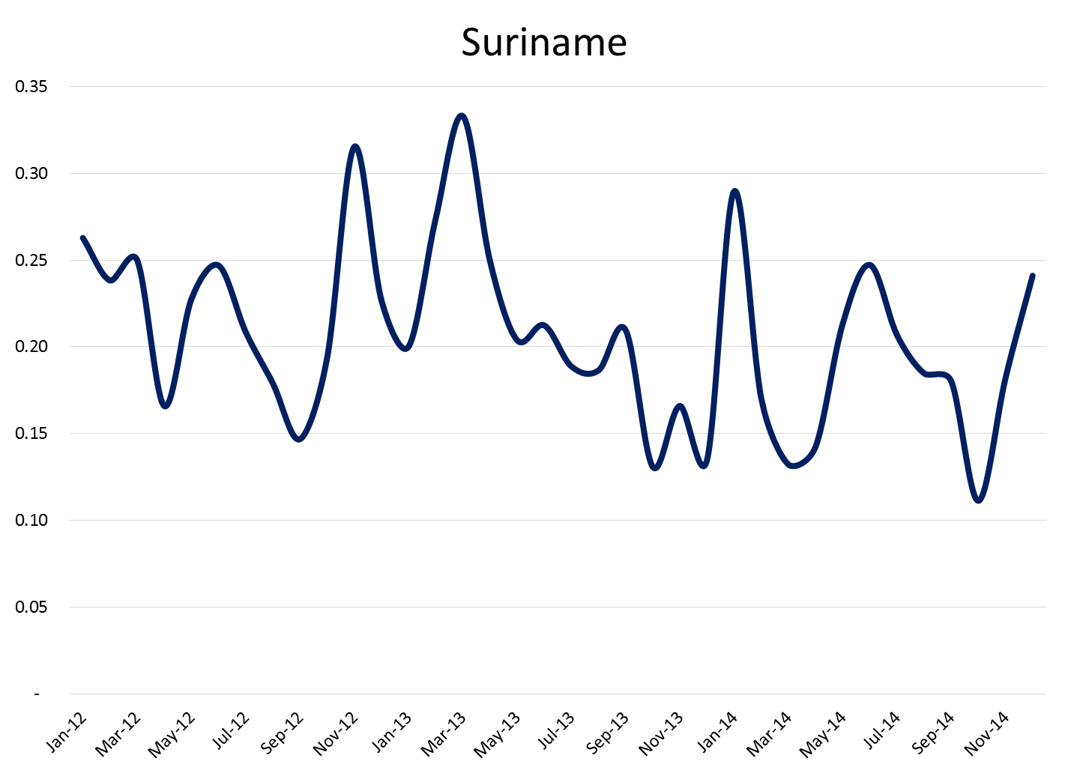
4.2b Composite Indicators of Systemic Stress

Slide 37
4.3 Stress-Testing Pension Funds
Stress Testing for Pension Funds is fairly new but a growing area internationally.
Less Common Tests: DC Plans (How adverse events affect targeted retirement income);
More Common Tests; DB Plans (Tests of whether solvency of the plan is maintained under adverse events).

Slide 38
4.3a: Stress-Testing Frameworks and Tests: Caribbean Experience (Macro-level)
SF- Single Factor Stress Test

Slide 39
#5 Pension Sector Contribution to Financial Stability Work Plan: Some Issues for Consideration.

Slide 40
5.1: Strategic Issues for Consideration
A. Financial Stability Indicators :
Rapidly improve the availability of financial health and stability indicators (i.e. FSIs) for the Pensions Sector.
RFSCC/CCMF has distributed a data request form for the pension sector to prepare for the Caribbean Financial Stability Report 2016 (See enhancements by Philip Davis).
Good Opportunity for CAPS in conjunction with the Caribbean Actuarial Association to move expeditiously to better organise and disseminate pension indicators in the Caribbean.
CARTAC has started to assist some countries with Upgrading Pension Reporting Forms and Developing Pension Indicators (Barbados, Belize, Guyana and Trinidad and Tobago);

Slide 41
Categories |  | Metric | Data
C.1 | Capital Adequacy | Funded Ratio: (Assets (end of year)/Liabilities (Actual and Projected benefit obligations (end of year)) | Assets ( end of Year ) ( US$M)
 |  |  | Defined Benefits (US$M)
 |  |  | Defined Contributions (US$M)
 |  |  | Liabilities (Actual and Projected Benefit obligations (end of Year )) (US$M)
C.2 |  | Capital of sponsor/(Assets-projected benefit obligations) | Capital of Sponsor (US$M)
 |  |  | Assets - Projected benefit obligations (US$M)
A.1 | Asset Quality | (Real estate + Government Bonds + Unquoted equities+ Debtors)/Total Assets | Real Estate (US$M)
 |  |  | Government Bonds (US$M)
 |  |  | Equities
 |  |  | Quoted equities (US$M)
 |  |  | Unquoted equities (US$M)
 |  |  | Debtors (US$M)
 |  |  | Total Assets (US$M)
 |  |  | of which Foreign Assets (US$M)

Slide 42
Categories |  | Metric | Data
M.1 | Management Quality | Pension Fund assets/No. of members | Private Pension Assets (US$M)
 |  |  | No. of members
M.2 |  | Gross contributions/No. of members | Gross Contributions (US$M)
 |  |  | No.of members
M.3 |  | Pension Fund Assets/Total Financial Sector assets | Pension Fund Assets (US$M)
 |  |  | Total Financial Sector Assets (US$M)
M.4 |  | Individuals covered by private pensions/Total labour force | Individuals covered by private pensions
 |  |  | Total Labour force

Slide 43
Categories |  | Metric | Data
E.1 | Earnings | Return on Assets : Earnings after taxes ( Interest earned + Dividends earned + Realized and unrealized gains or losses) - (Taxes payable by the plan+ Administrative costs of the plan) / Average Assets | Interest earned (US$M)
 |  |  | Dividends earned (US$M)
 |  |  | Realized and unrealized gains or losses (US$M)
 |  |  | Taxes payable by the plan (US$M)
 |  |  | Administrative costs of the plan (US$M)
 |  |  | Average Assets (US$M)
L.1 | Liquidity | Liquid Assets (1 year and under maturity)/Total Assets | Liquid Assets ( 1 year and under maturity) (US$M)
 |  |  | Total Assets (US$M)
L.2 |  | Current Assets/Current Liabilities | Current Assets (cash , near cash and assets < 1year) (US$M)
 |  |  | Current Liabilities < 1 year (US$M)
L.3 |  | Liquidity Ratio (Liquid Assets / Estimated pension payments in the next year ) | Liquid Assets (US$M)
 |  |  | Estimated Pension Payments in the next year (US$M)

Slide 44
5.1 (cont’d): Strategic Issues for Consideration
B. Interconnectedness Project:
Intensify and sustain current efforts on the regional interconnectedness project to get a better idea of how pension funds link with the rest of the financial system at a national and even regional level (through investments). CAPS and CAA need to participate actively in this exercise.

Slide 45
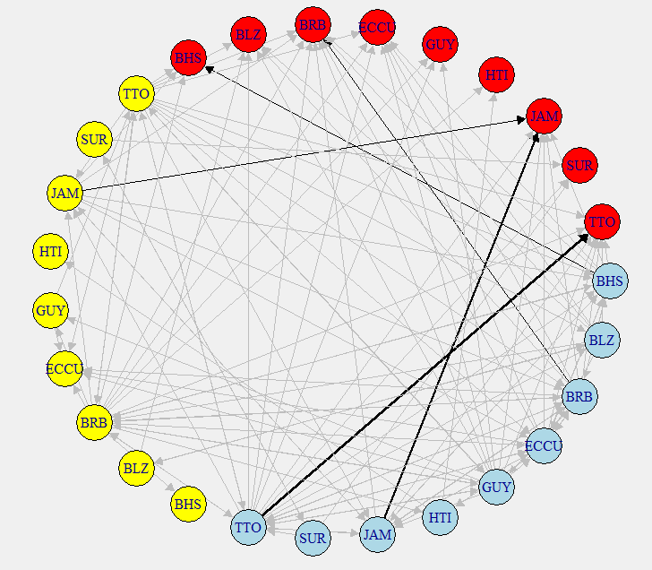
5.1a Interconnection Map
Interconnection Map indicates high degree of exposure of insurance sector to sovereign
We need to establish the various connections for the pension sector which are not available in the current maps.
Red: Sovereign
Blue: Banks
Yellow: Insurance

Slide 46
5.1 (cont’d) : Strategic Issues for Consideration
C. Stress- Testing Pension Sector
Jurisdictions need to strengthen and expand stress-testing capability for the pensions sector both at a micro-prudential and macro-prudential level.
D. Financial Disclosure, Transparency and Reporting
Barring a few exceptions, there are still gaping holes in consistent financial disclosure and reporting on the pension sector in the Caribbean.

Slide 47
Table 1A:
Financial Stability Reporting in the Caribbean: Pre-Financial and Post-Financial Crisis Years
Country | Published By | Pre-Financial Crisis FSRs (2005-2007) | Financial Crisis FSRs (2008-2009) | Post-Financial Crisis FSRs (2010-2015) | CARTAC Assistance on Financial Stability Reporting
 | CARICOM Members
Bahamas | Central Bank | Nil | Nil | 2012-2015 | No
Barbados | Central Bank | Nil | Nil | 2011-2015 | No
Belize | Central Bank | Nil | Nil | 2015 (Published in 2016) | Yes (2015)
ECCU | Central Bank | Nil | Nil | Draft 2015 report being revised. | Yes (2016)
Guyana | Central Bank | 2006-2007 (as part of Annual Report) | 2008-2009 (as part of Annual Report) | 2010-2015 | No
Haiti | Central Bank | Nil | Nil | Nil | No
Jamaica | Central Bank | 2005-2007 | 2008-2009 | 2010-2015 | No
Suriname | Central Bank | Nil | Nil | 2015 | Yes (2015)
Trinidad and Tobago | Central Bank | Nil | 2008-2009 | 2010-2015 | No
Regional | CCMF | Nil | Nil | 2015 | Yes (2015)

Slide 48
Table 1B:
Sectoral Coverage of latest Published Financial Stability Reports
Country | Banking Sector | Insurance Sector | Credit Union Sector | Pensions | Mutual Funds | Securities Mkts | Payment Systems
Bahamas (2015) | √3 | √2 | √2 | ×0 | ×0 | √1 | √1
Barbados (2015) | √3 | √1 | √1 | √1 | ×0 | ×0 | ×0
Belize (2015) | √3 | √2 | √1 | ×0 | ×0 | ×0 | ×0
Guyana (2015) | √3 | √1 | ×0 | √1 | ×0 | ×0 | √1
Jamaica (2015) | √3 | √3 | √1 | √3 | √3 | √3 | √3
Suriname (2015) | √3 | √2 | √1 | √1 | ×0 | ×0 | √1
Trinidad and Tobago (2015) | √3 | √3 | ×0 | √1 | ×0 | ×0 | √1
Regional (2015) | √3 | √2 | ×0 | √1 | ×0 | √1 | ×0
0 – No coverage; 1 – limited coverage;
2 – Moderate Coverage; 3 – Full coverage.

Slide 49
END OF PRESENTATION

