Slide 1
Caribbean Association of Pension Regulators (CAPS) 2018 Conference
Enhancing the Micro and Macro Dimensions of Pension Regulation and Supervision
Framework for Assessing the Effectiveness of Plan Administrators, Investment Managers and Trustees
(Trinidad and Tobago)
Naveen Lalla
June 19, 2018

Slide 2
Presentation Outline
Purpose of Assessment
Framework of Assessment
Methods of Assessment
Terms of Reference
Challenges
Conclusion

Slide 3
Purpose of Assessment
Occupational Pension Plans are important players in the Financial Industry and have a key social role in financing retirement income.
The assets of this sector represent a significant portion (≈16%) of the total assets of the financial sector of Trinidad and Tobago.
As at May 31, 2018, active pension plan assets totaled approximately $49.4 billion and membership totaled approximately 96,000 persons.
As such, they should be managed by competent personnel who are aware of their roles, responsibilities and accountabilities, and who conduct their activities in an accurate, consistent, equitable and transparent manner.
Notes:
16% of financial sector assets (taken from 2015 FSR)

Slide 4
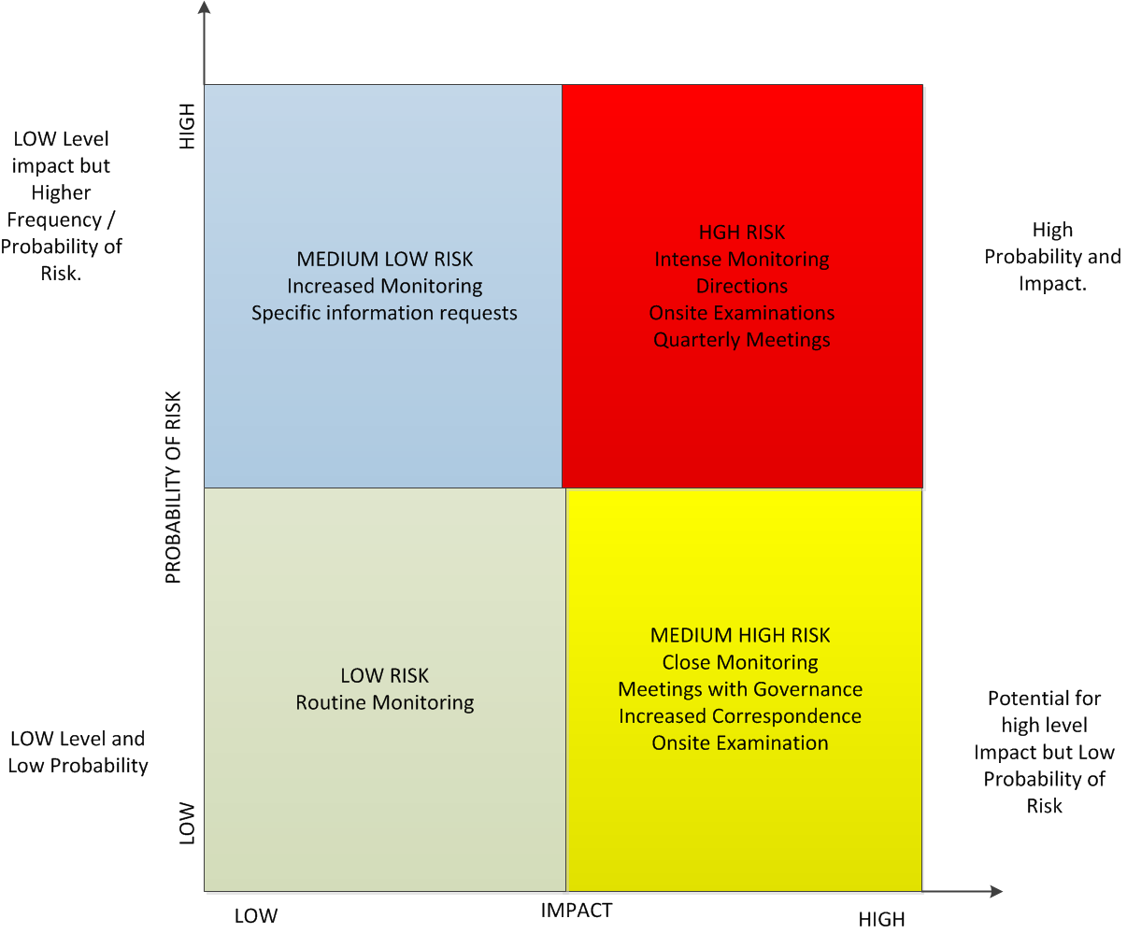
Framework of Assessment
Risk-Based Framework
The Central Bank has adopted a risk-based approach to the Supervision of Pension Plans. The framework for assessing the effectiveness of the Plan Administrators, Investment Managers and Trustees is derived from this.
There are currently 188 Active Pension Plans in Trinidad and Tobago. The method of assessment and hence the depth of analysis is dependent on the risk category of the Pension Plan.

Slide 5
Methods of Assessment
On-site Supervision
One of the primary tools used by the regulator is the On-Site Supervision. It is used to acquire the necessary information needed to assess the pension plan.
In its role as the main regulator and supervisor of Occupational Pensions Plans in Trinidad & Tobago, the Central Bank reviews the following:
Written policies and procedures relating to the Administration and Trusteeship of Pension Plans.
Statements of Investment Policy of Pension Plans.
Computer Systems used in the administration of Pension Plans.
Compliance Reports and Internal Audit Reports done on the Administration and Trusteeship of Pension Plans.

Slide 6
Methods of Assessment
On-site Supervision (Cont’d)
The following main areas are assessed by the Central Bank:
Administration of Pension Plans.
Statutory reporting and compliance with the Insurance Act, Chap. 84:01.
Nature and frequency of Communication with Stakeholders.
Compliance with the Pension Plan’s Statement of Investment Policy.
Recording, reporting and handling of queries and complaints.
Business continuity / disaster recovery.
Archiving and record keeping.
Notes:
Additional areas of assessment
Recording of contributions received and follow-up on contributions receivable
Calculation and payment of benefits including monthly pension payroll
Role and duties as the Trustee of Self-administered and Insured Pension Plans
To review the information technology used to store and maintain data on Pension Plans

Slide 7
Methods of Assessment
Off-site Supervision
The Central Bank conducts Off-site supervision of Pension Plans by examining the statutory submissions. Additional requests for further information may be made to satisfy the Regulator. The following documents are reviewed to assess Pension Plans:
Annual Financial Statements
Semi-Annual Returns
Triennial Actuarial Valuation Returns
Annual Governance Questionnaires*
Annual Compliance Report (Specific Plans)
Quarterly updates from Plans on specific matters
*The Governance Questionnaire is being introduced with a view to aid the Central Bank in narrowing information gaps about Pension Plans.

Slide 8
Methods of Assessment
Off-site Supervision (Cont’d)
The documents are examined to identify the following:
Any irregular transactions or conditions.
Any issues such as whether recommendations made by the actuary are not being followed.
Any contraventions of the pension plan’s TD&R.
Any breaches of the Legislation.
These issues can signal early warning signs regarding the trusteeship, administration and investment management pension plans.
Notes:
Irregular transactions – eg. outstanding/incorrect payments by Trustee/Administrator.

Slide 9
Terms of Reference
The Central Bank of Trinidad and Tobago has developed Guidelines for the Pension Industry to ensure that the relevant entities understand their mandates and fulfill these in accordance with best practices. The Guidelines that are applicable to the Plan Administrators, Trustees and Investment Managers are as follows:
Trustees and Plan Administrators:
Draft Guideline on Pension Plan Governance
Investment Managers:
Prudent Person Approach to Investment and Lending Guideline
These Guidelines serve as Terms of Reference for the Regulator when assessing the effectiveness of the Plan Administrators, Trustees and Investment Managers.
Notes:
The Draft Guidelines are scheduled to be issued to the Industry in 2018/2019
The Prudent Person Approach to Investment and Lending Guideline can be viewed on the Central Bank of Trinidad and Tobago website.

Slide 10
Challenges
Lack of awareness of fiduciary duties
Regulatory resource restrictions
Inadequate Legislation
Notes:
How do we deal with these challenges. By doing the following:
Continuous communication with all stakeholders
Education - Issuance of guidelines and circulars
Feedback to the industry

Slide 11
Questions?
Thank you

